Slide 3
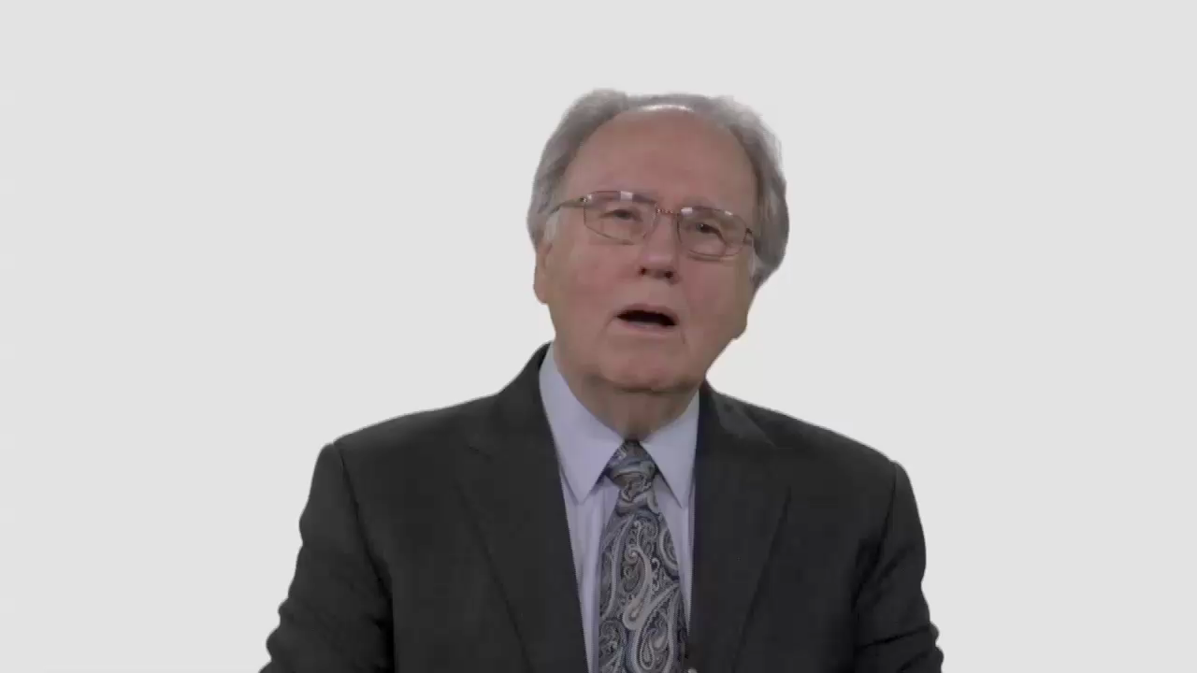

Slide 4
Have Your Say.
How well does the Seventh-day
Adventist Church demonstrate
Christ’s “radical equality?”

Slide 5
Conversation Builders.
Are Adventists followers or
leaders when it comes to
breaking down racial divisions?

Slide 6
Conversation Builders.
How can we tackle racial
divisions within our Church?

Slide 7
Discussion Questions.
Do significant tension points
of culture, race, or ethnicity
exist within your congregation?

Slide 8
Discussion Questions.
To what extent are differences
and tensions inevitable—even healthy
—within the body of Christ?

Slide 9
Discussion Questions.
If someone from your community visited your church on Sabbath morning, how would the worship service look through his or her eyes?

Slide 10
Discussion Questions.
Do you think your congregation
would seem an inclusive,
welcoming place for minorities?

Slide 11
Discussion Questions.
Would it be helpful for the Adventist
Church to be more deliberate in
acknowledging its past and present
failures to “practice what we preach”
when it comes to race relations?

Slide 12
What Now?
What could change in your local
church that would better
demonstrate equality in Christ?

